Slide 1
Catering
Maths in the workplace

Slide 2
How our teaching resources are designed for the classroom

Slide 3
I can understand how maths is used in the catering industry.

Slide 4
Metric units are based around the standard units of metre, gram and litre.
Percentage loss is the decrease when referencing something that loses cost/mass/length, etc. given as a percentage of the original amount.

Slide 5

Catering
Measures in catering
Percentages in catering

Slide 6
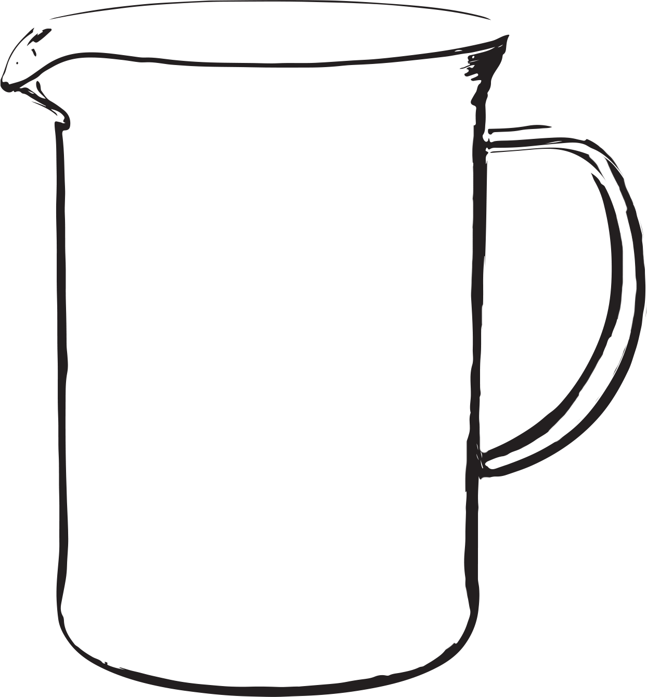
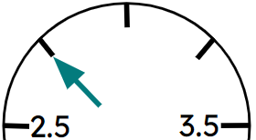

Measures in catering
What areas of maths do you think a caterer might use?
Measures
Money
Conversions
Proportion
Percentages
Ratio
Temperature
kg
During this lesson we will look at the majority of these.

Slide 7
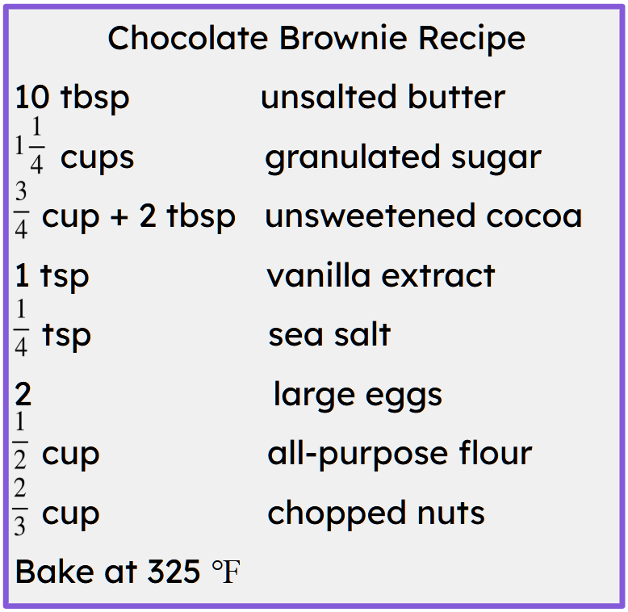
Measures in catering
Often recipes are written in US terms.
A caterer needs to be able to convert these measures into metric units.

Slide 8

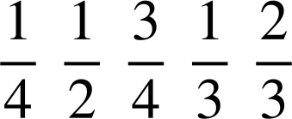
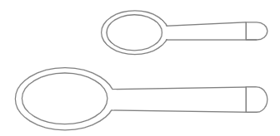
Measures in catering
1 gram ≈ ^{th} tbsp
1 cup
1 cup
tsp
5 ml
tbsp
3 tsp
Is there enough information to convert all of the measurements into metric units? (Grams and millilitres)
No. The teaspoon and tablespoons can be converted but not the cup measurements.

Slide 9
Measures in catering
1 gram ≈ ^{th} tbsp
1 cup
1 cup
tsp
5 ml
tbsp
3 tsp
What other pieces of information do you need to convert the cup measurements into metric units?
Some information about the capacity of a cup.

Slide 10
Measures in catering
1 gram ≈ ^{th} tbsp
1 cup
1 cup
1 cup = 16 tbsp
tsp
5 ml
tbsp
3 tsp
Is there enough information now to convert all of the cup measurements into metric units?
Yes.
Convert all of the cup and spoon measurements into metric units.

Slide 11
Measures in catering
Before we go through those conversions, let’s think about which of our ingredients need to be converted into grams and which into millilitres.
What are grams a metric measure of?
Grams are a metric measure of mass. (The solid ingredients)

Slide 12
Measures in catering
Before we go through those conversions, let’s think about which of our ingredients need to be converted into grams and which into millilitres.
What are millilitres a metric measure of?
Millilitres are a metric measure of capacity. (Liquids)

Slide 13
Measures in catering
Which of the brownie ingredients will we measure in grams?
Butter
Sugar
Cocoa
Sea salt
Flour
Nuts
Which of the brownie ingredients will we measure in millilitres?
Vanilla extract

Slide 14
Measures in catering
1 gram ≈ ^{th} tbsp
16 tbsp
1 cup
1 cup
224 g
1 cup = 16 tbsp
12 tbsp
168 g
8 tbsp
112 g
tsp
5 ml
≈ 4.7 grams
4 tbsp
56 g
tbsp
≈ 14 grams
3 tsp
Starting with measures of mass.
Convert all cup and spoon measurements into grams.

Slide 15
Measures in catering
1 gram ≈ ^{th} tbsp
224 g
1 cup
16 tbsp
1 cup
1 cup = 16 tbsp
168 g
112 g
tsp
5 ml
≈ 4.7 grams
56 g
tbsp
≈ 14 grams
3 tsp
Now measures for the cup split into thirds.
Why might this cause a problem?
3 is not a factor of 16.

Slide 16
Measures in catering
1 gram ≈ ^{th} tbsp
224 g
1 cup
225.6 g
1 cup
48 tsp
16 tbsp
1 cup = 16 tbsp
168 g
32 tsp
150.4 g
112 g
tsp
5 ml
16 tsp
≈ 4.7 grams
75.2 g
56 g
tbsp
≈ 14 grams
3 tsp
What would be a solution to this problem?
Use teaspoons rather than tablespoons.

Slide 17
Measures in catering
1 gram ≈ ^{th} tbsp
225.6 g
1 cup
224 g
1 cup
1 cup = 16 tbsp
150.4 g
149.3 g
tsp
5 ml
75.2 g
≈ 4.7 grams
74.7 g
tbsp
≈ 14 grams
3 tsp
Let’s see what happens if I use the fact that we know that 1 cup = 224 grams.
Why are the measurements slightly different?

Slide 18
Measures in catering
1 gram ≈ ^{th} tbsp
225.6 g
225 g
1 cup
224 g
225 g
1 cup
1 cup = 16 tbsp
150.4 g
150 g
149.3 g
150 g
tsp
5 ml
75.2 g
75 g
≈ 4.7 grams
74.7 g
75 g
tbsp
≈ 14 grams
3 tsp
Why are the measurements slightly different?
These are approximate values.
What would the most appropriate measurement to use?

Slide 19
Measures in catering
1 gram ≈ ^{th} tbsp
16 tbsp
1 cup
1 cup
240 ml
1 cup = 16 tbsp
12 tbsp
180 ml
8 tbsp
120 ml
tsp
5 ml
4 tbsp
60 ml
tbsp
15 ml
3 tsp
Starting with measures of capacity.
Convert all cup and spoon measurements into millilitres.

Slide 20
Measures in catering
1 gram ≈ ^{th} tbsp
240 ml
1 cup
240 ml
1 cup
1 cup = 16 tbsp
180 ml
160 ml
120 ml
tsp
5 ml
80 ml
60 ml
tbsp
14 grams
3 tsp
Now measures for the cup split into thirds.

Slide 21
Measures in catering
Cups can be converted into grams or millilitres. The conversion rate we have used here is one conversion rate.
However, the conversion rate can differ depending on what we are measuring and it is important to be aware of this.

Slide 22
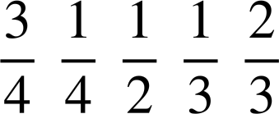
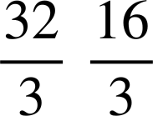
Measures in catering
Fill in the missing measurements.
Cups | Tablespoons | Teaspoons | Grams | Millilitres
1 | 16 | 48 | g | ml
 | 12 |  | ≈ g | 180 ml
 |  |  | 150 g | ml
 |  | 24 | ≈ g | 120 ml
 |  |  | g | 80 ml
 |  | 12 | 56 g | ml

Slide 23
Measures in catering
Fill in the missing measurements.
Cups | Tablespoons | Teaspoons | Grams | Millilitres
1 | 16 | 48 | 224 or 225 g | 240 ml
 | 12 | 36 | ≈ 168 g | 180 ml
 |  | 32 | 150 g | 160 ml
 | 8 | 24 | ≈ 112 g | 120 ml
 |  | 16 | 75 g | 80 ml
 | 4 | 12 | 56 g | 60 ml

Slide 24
Measures in catering
Now we can convert the ingredients in the recipe.
Butter = 10 × 14 = 140 g
Sugar = 224 + 56 = 280 g
Cocoa = 168 + 2 × 14 = 196 g
Vanilla = 5 ml
Salt = 5 ÷ 4 = 1.25 g
Flour = 112 g or 112.5 g
Nuts = 150 g
Can we now bake the brownies?
Ovens in the UK use ℃ not ℉.

Slide 25

Measures in catering
To convert ℉ into ℃
Subtract 32 multiply by
(325 − 32) ×
= 163 ℃ (nearest integer)

Slide 26
Measures in catering
To convert ℉ into ℃
Subtract 32 multiply by
To convert ℉ into ℃
Subtract 32 multiply by
Convert 260 ℉ into ℃.
Give your answer to the nearest integer.
Convert 450 ℉ into ℃.
Give your answer to the nearest integer.
(260 − 32) ×
= 127 ℃
(450 − 32) ×
= 232 ℃

Slide 27

Measures in catering
420 ℉ = 402 ℃ (nearest integer)
What mistake do you think was made?
The order of operations is incorrect. When inputting into a calculator input:
(420 − 32) × = 216 ℃

Slide 28



Measures in catering
1) Convert the following recipes and oven temperatures into UK units of measure.
Pancake Recipe
b) Scone Recipe
1 cup flour
2 tbsp sugar
2 tsp baking powder
1 pinch of salt
1 cup milk
2 tbsp melted butter
1 large egg
3 cups flour
cup caster sugar
2 tsp baking powder
cup softened butter
cup milk
Oven temperature 392 ℉

Slide 29
Measures in catering
1) Convert the following recipes and oven temperatures into UK units of measure.
a) Pancake Recipe
1 cup flour 225 g or 224 g
2 tbsp sugar 28 g
2 tsp baking powder 9 g
1 pinch of salt
1 cup milk 240 ml
2 tbsp melted butter 28 g
1 large egg
b) Scone Recipe
3 cups flour 675 g or 672 g
cup caster sugar 56 g
2 tsp baking powder 9 g
cup softened butter 112 g
cup milk 320 ml
Oven temperature 200 ℃

Slide 30
Catering
Measures in catering
Percentages in catering

Slide 31
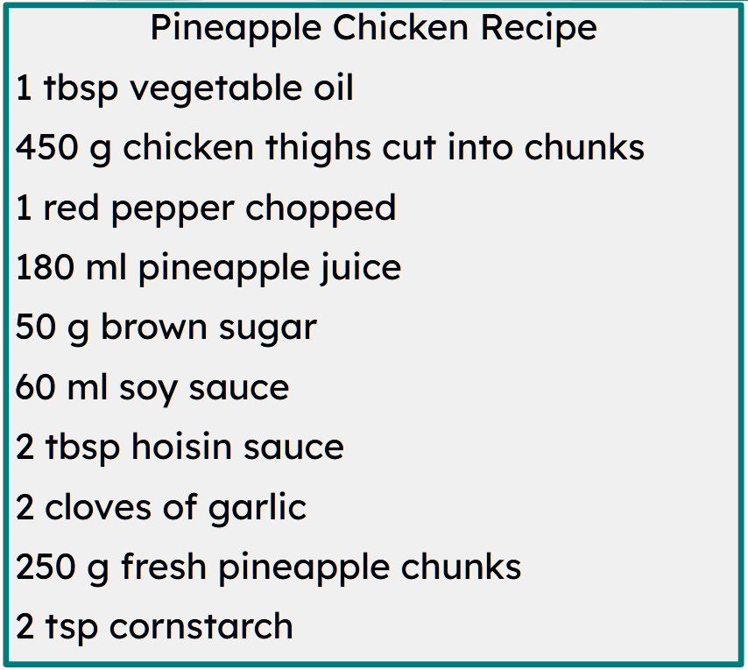
Percentages in catering
Some foods need preparing before they are used in a recipe.
Do you think that any of the ingredients for this recipe would produce any wastage?
The red pepper, chicken thighs, garlic and pineapple chunks.

Slide 32
Percentages in catering
Although the pepper and garlic produce wastage this does not affect the recipe.
The wastage of the chicken and pineapple do need to be considered though.
Caterers use percentages to work out how much of particular items they need to buy for recipes.

Slide 33
Percentages in catering
Pineapple Chicken Recipe
450 g chicken thighs cut into chunks
250 g fresh pineapple chunks
Once a product is cleaned, trimmed, and portioned it is called the Edible Portion (EP). The EP is important because it reflects the true quantity needed and the true cost of the food.
Caterers use percentage yield values to calculate the EP.
Food | Percentage yield
Chicken thighs | 79 %
Pineapple | 52%

Slide 34
Percentages in catering
There are tables that chefs and caterers can use which give an average percentage yield.
However, many will calculate their own based on the equipment, quality and the intended use of the ingredients.
How do you think a percentage yield is calculated?
Weigh the mass of the purchased product. Prepare the product and reweigh it.
Percentage yield = mass of prepared product × 100
mass of purchased product

Slide 35
Percentages in catering
Percentage yield = mass of prepared product × 100
mass of purchased product
A chef prepares 5 kg of kale.
The prepared product has a mass of 3.7 kg.
What is the percentage yield?
Percentage yield = 3.7 × 100
5
= 74 %

Slide 36
Percentages in catering
What is the percentage yield for a chef that purchases 20 kg of sweet potatoes and, after preparation, has 16 kg of sweet potatoes?
What is the percentage yield for a chef that purchases 4 kg of mushrooms and, after preparation, has 3.88 kg of mushrooms?
% yield = 16 × 100
20
% yield = 3.88 × 100
4
= 80 %
= 97 %

Slide 37
Percentages in catering
Pineapple Chicken Recipe
450 g chicken thighs cut into chunks
250 g fresh pineapple chunks
Food | Percentage yield
Chicken thighs | 79 %
Pineapple | 52%
A 79 % yield means that only 79 % of the purchase weight is usable.
What weight of chicken thighs needs to be purchased to be left with 450 g after the preparation is done?
EP = 79 % of the purchase mass
450 g = 0.79 × purchase mass
Purchase mass = 450 ÷ 0.79
= 569.6 g (1 d.p.)
= 570 g (nearest gram)

Slide 38
Percentages in catering
Pineapple Chicken Recipe
450 g chicken thighs cut into chunks
250 g fresh pineapple chunks
Food | Percentage yield
Chicken thighs | 79 %
Pineapple | 52%
What weight of pineapple needs to be purchased to be left with 250 g after the preparation is done?
EP = 52 % of the purchase mass
250 g = 0.52 × purchase mass
Purchase mass = 250 ÷ 0.52
= 480.8 g (1 d.p.)
= 481 g (nearest gram)

Slide 39
Percentages in catering
The percentage yield of a butternut squash is 66 %.
A restaurant needs 10 kg of butternut squash to make soup.
How many kilograms of butternut squash do they need to buy?
Give your answer to 1 decimal place.
The percentage yield of an onion is 89 %.
A restaurant needs 5 kg of onions to make soup.
How many kilograms of onions do they need to buy?
Give your answer to 1 decimal place.
10 kg = 0.66 × purchase mass
Purchase mass = 10 ÷ 0.66
= 15.2 kg
5 kg = 0.89 × purchase mass
Purchase mass = 5 ÷ 0.89 = 5.61…
= 5.7 kg*

Slide 40
Percentages in catering
* Why did we round up and not down?
If the restaurant only bought 5.6 kg of onions then that would result in 4.984kg after preparation.
The restaurant needs 5 kg.
So we round up to ensure we have enough.
The percentage yield of an onion is 89 %.
A restaurant needs 5 kg of onions to make soup.
How many kilograms of onions do they need to buy?
Give your answer to 1 decimal place.
5 kg = 0.89 × purchase mass
Purchase mass = 5 ÷ 0.89 = 5.61…
= 5.7 kg*

Slide 41
Percentages in catering
1) Calculate the purchase mass in order to have 1 kg of each food listed in the table.
(Give your answers to the nearest gram)
Food | Percentage yield | Calculation | Mass to purchase
Beef | 80 %
Cauliflower | 55 %
Leeks | 75 %
Parsnips | 85 %
Whole salmon | 70 %

Slide 42
Percentages in catering
2)
Food | % yield | Cost per kg
Cabbage | 79 % | £1.50
Carrots | 97 % | 77 p
Celery | 75 % | £3.60
Onions | 89 % | £1.07
Potatoes | 81 % | £1.55
Vegetables for Soup (5 servings)
560 g chopped onions
350 g chopped carrots
450 g chopped celery
620 g potatoes
1.27 kg cabbage
a) Calculate the mass (to the nearest gram) for each vegetable that the restaurant needs to buy to ensure they can make 50 servings of soup.

Slide 43
Percentages in catering
2)
Food | % yield | Cost per kg
Cabbage | 79 % | £1.50
Carrots | 97 % | 77 p
Celery | 75 % | £3.60
Onions | 89 % | £1.07
Potatoes | 81 % | £1.55
Vegetables for Soup (5 servings)
560 g chopped onions
350 g chopped carrots
450 g chopped celery
620 g potatoes
1.27 kg cabbage
b) Assuming the cost is proportional to the mass, what is the cost to buy the necessary vegetables? (Round up to the nearest penny.)

Slide 44
Percentages in catering
2)
Food | % yield | Cost per kg
Cabbage | 79 % | £1.50
Carrots | 97 % | 77 p
Celery | 75 % | £3.60
Onions | 89 % | £1.07
Potatoes | 81 % | £1.55
Vegetables for Soup (5 servings)
560 g chopped onions
350 g chopped carrots
450 g chopped celery
620 g potatoes
1.27 kg cabbage
c) How much do you think the restaurant should charge for a bowl of soup?

Slide 45
Percentages in catering
1) Calculate the purchase mass in order to have 1 kg of each food listed in the table.
(Give your answers to the nearest gram)
Food | Percentage yield | Calculation | Mass to purchase
Beef | 80 % | 1 ÷ 0.8 | 1.250 kg
Cauliflower | 55 % | 1 ÷ 0.55 | 1.819 kg*
Leeks | 75 % | 1 ÷ 0.75 | 1.334 kg*
Parsnips | 85 % | 1 ÷ 0.85 | 1.177 kg*
Whole salmon | 70 % | 1 ÷ 0.7 | 1.429 kg

Slide 46
Percentages in catering
2)
Food | Purchase | % yield | Cost per kg
Cabbage | 16.076 kg | 79 % | £1.50
Carrots | 3.609 kg | 97 % | 77 p
Celery | 6 kg | 75 % | £3.60
Onions | 6.293 kg | 89 % | £1.07
Potatoes | 7.655 kg | 81 % | £1.55
Vegetables for Soup (50 servings)
5.6 kg chopped onions
3.5 kg chopped carrots
4.5 kg chopped celery
6.2 kg potatoes
12.7 kg cabbage
a) Calculate the mass (to the nearest gram) for each vegetable that the restaurant needs to buy to ensure they can make 50 servings of soup.

Slide 47
Percentages in catering
2)
Vegetables for Soup (50 servings)
5.6 kg chopped onions
3.5 kg chopped carrots
4.5 kg chopped celery
6.2 kg potatoes
12.7 kg cabbage
Food | Purchase | Cost per kg | Total cost
Cabbage | 16.076 kg | £1.50 | £24.12
Carrots | 3.609 kg | 77 p | £2.78
Celery | 6 kg | £3.60 | £21.60
Onions | 6.293 kg | £1.07 | £6.74
Potatoes | 7.655 kg | £1.55 | £11.87
b) Assuming the cost is proportional to the mass, what is the cost to buy the necessary vegetables? (Round up to the nearest penny.)
Total cost = £67.11

Slide 48
Percentages in catering
2)
Food | Purchase | Cost per kg | Total cost
Cabbage | 16.076 kg | £1.50 | £24.12
Carrots | 3.609 kg | 77 p | £2.78
Celery | 6 kg | £3.60 | £21.60
Onions | 6.293 kg | £1.07 | £6.74
Potatoes | 7.655 kg | £1.55 | £11.87
Vegetables for Soup (50 servings)
5.6 kg chopped onions
3.5 kg chopped carrots
4.5 kg chopped celery
6.2 kg potatoes
12.7 kg cabbage
c) How much do you think the restaurant should charge for a bowl of soup? Total cost = £67.11 Cost per portion = £1.35
However, this does not take into account the other ingredients, staff & energy costs or the amount of profit you wish to make.

Slide 49
Catering
It is necessary to convert between US and metric units of measurement when using recipes.
US recipes tend to use cups and spoons as their units of measurement and UK recipes use the metric units of grams and kilograms. (You may see some old UK recipes using pounds and ounces).
Caterers use percentage yields when calculating products to buy as these consider the wastage of the product.

Slide 50

© Oak National Academy 2024.
Produced in partnership with Mathematics in Education and Industry.
Licensed on the Open Government Licence v3.0, except where otherwise stated. See Oak terms and conditions.

